Slide 1

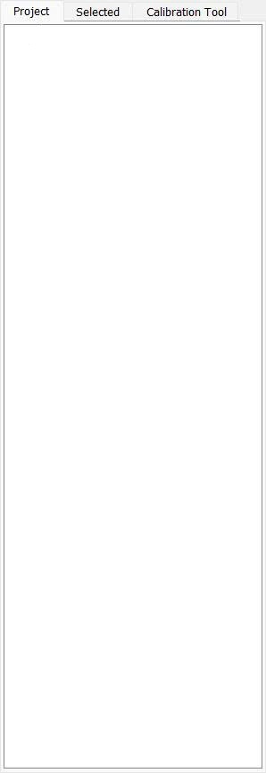

Camera Configuration
X
Camera:
V
Camera Thread
Connect
Disconnect
Apply and Close
Cancel
Hardware Configuration
X
Port:
V
Baud:
V
Status Query Period:
ms
Apply and Close
Cancel

Slide 2
Syringe Control
X
Height:
V
mm
Speed:
V
rpm
Close
Refill
Status Query Period:
ms

